Slide 1

课时练习
期中复习五 模块八 第二章

Slide 2
一、根据语境、 音标或所给单词的提示完成句子， 每空一词。
1. He is one of Dr. Li’s __________ (patient).
2. A reporter will come to __________ /'ɪntə(r)vjuː/ the hero tomorrow.
3. If I remember __________ (correct), there is a comb(梳子) on the dressing table.
patients
interview
correctly

Slide 3
一、根据语境、 音标或所给单词的提示完成句子， 每空一词。
4. They took steps to prevent the __________ /spred/ of COVID-19.
5. My father _________ uniforms when he’s at work.
spread
wears

Slide 4
二、 重点句型。
1. 这取决于谁来设计我们的校服。
It _______________________________________
_________________________________________.
2. 得体的制服确实能展示良好的纪律。
It’s true that ______________________________
_________________________________________.
3. 制服可以阻止一些人做坏事。
Uniforms may ____________________________
_________________________________________.
depends on who will design our school uniforms
suitable uniforms can show good discipline
stop/keep/prevent some people from doing bad things

Slide 5
二、 重点句型。
4. 在日本，当你进入别人家时，应该脱鞋。
In Japan, you should __________________________
_____________________________________________.
5. 消防员穿上特制的外套和头盔，以保护自己免受高温和坠落的天花板的伤害。
Firefighters wear ______________________________
_________________________ heat and falling ceilings.
take off your shoes when you enter/when entering someone’s home
special coats and helmets to protect themselves from

Slide 6
三、重点语法。
★宾语从句Ⅲ
(A)根据所学知识, 将横线上的内容补充完整。
1. 把特殊疑问句变为宾语从句时，从句由原来的疑问 _______（who, what等）或疑问副词（where, when, why, how等）引导，这些词在从句中充当一定的句子成分，都有各自的词义，不可省略。
代词

Slide 7
三、重点语法。
2. 把特殊疑问句变成宾语从句时，要用 _______ 语序。如果主句的谓语动词是一般现在时，宾语从句的谓语动词可根据需要使用各种时态。
陈述

Slide 8
三、重点语法。
(B)根据中文提示完成句子。 (每条横线不限词数。)
1. 我想知道你什么时候会去上海。
I want to know _________________________________.
2. 你知道Cindy为什么正在哭吗？
Do you know __________________________________?
3. 你能告诉我你最喜欢哪件毛衣吗？
Can you tell me ________________________________?
when you will go to Shanghai
why Cindy is crying
which sweater you like best

Slide 9
三、重点语法。
(B)根据中文提示完成句子。 (每条横线不限词数。)
4. 你知道昨天是谁给我们做演讲吗？
Do you know ________________________ yesterday?
5. 你能告诉我你多经常给你父母写信吗？
Can you tell me _______________________________?
who gave us the speech
how often you write to your parents

Slide 10
四、单项选择。
( )1. —The old man still _________ a thin coat though it’s winter.
—Maybe we can give him some old clothes.
A. puts on B. dresses C. wears
C

Slide 11
四、单项选择。
( )2. Porcelain(瓷) can be used for making cups ________ plates.
A. instead of B. as well as C. as well
B

Slide 12
四、单项选择。
( )3. A person with good manners never laughs at people when they are _____________.
A. out of danger B. in trouble C. on holiday
B

Slide 13
四、单项选择。
( )4. —She speaks English so well. I guess she is ________ from the UK ________ the US.
—In fact，she is Chinese.
A. either; or
B. both; and
C. not only; but also
A

Slide 14
四、单项选择。
( )5. Male penguins(企鹅) __________ the task of incubating(孵) eggs when their wives are away for food.
A. put up B. carry out C. try out
B

Slide 15
四、单项选择。
( )6. —How are you going to spend this Sunday?
—It _________ the weather. If it’s fine, I’ll go
fishing.
A. looks at B. decides on C. depends on
C

Slide 16
四、单项选择。
( )7. She doesn’t like leather shoes ___________ they look ugly on her.
A. so B. because C. though
B

Slide 17
四、单项选择。
( )8. We must stop people _______ litter everywhere.
A. picking up B. to throw C. from throwing
C

Slide 18
四、单项选择。
( )9. —Could you please tell me ______?
—Yes. At 6:30 p.m.
A. how he will go to Beijing
B. when the plane takes off
C. what color does he like best
B

Slide 19
四、单项选择。
( )10. —Could you tell me ______________?
—Throwing off poverty(脱贫).
A. who people often talk about this year
B. what people often talk about this year
C. which do people often talk about this year
B

Slide 20
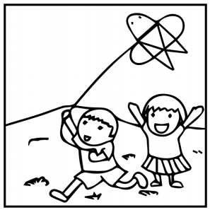
五、看图写话。
1. whether, depend, weather
Whether they will fly a kite (or not) depends on the weather.

Slide 21
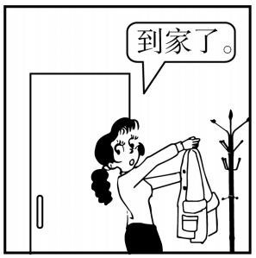
五、看图写话。
2. as soon as
The girl/She took off her coat as soon as she got/arrived home.

Slide 22
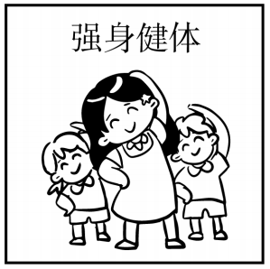
五、看图写话。
3. exercise
The children do exercise to build them up./
They exercise to build themselves up.

Slide 23
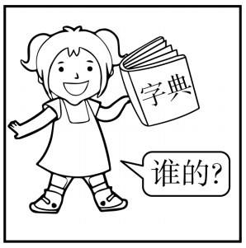
五、看图写话。
4. ask
The girl/She asked whose dictionary it was.

Slide 24
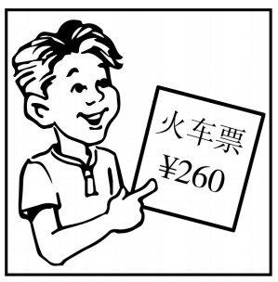
五、看图写话。
5. pay
The boy/He paid 260 yuan for the train ticket.

Slide 25
六、情景交际。
1. 你想向对方打听哪里可以买到雨衣, 可以这样问：
Excuse me, could you tell me ____________________
_____________________________________________?
2. 你想知道对方对你这条裤子的看法, 可以这样问：
_____________________________________________?
_____________________________________________?
3. 你想知道对方喜欢穿什么去上学, 可以这样问：
_____________________________________________?
where to buy a raincoat/where I can buy a raincoat
What do you think of this pair of pants
How do you like my trousers
What do you like to wear to school

Slide 26
六、情景交际。
4. 你到店里买鞋，店员会这样询问你的码数：
_________________________________________?
5. 你想知道对方穿制服的场合，可以这样问：
_________________________________________?
What size (shoes) do you take/want/wear
On what occasion do you wear uniforms

Slide 27
七、短文填空。
One day, a teacher was 1 (give) a class to his students. He put a glass of water on the desk and asked them, “How heavy do you think this glass of water is?”
The students 2 (begin) to think and guess. Their 3 (answer) were different, from 20g to 500g.
“It doesn’t matter how heavy this glass of water is. The weight(重量)we feel depends on how 4 we hold it.
giving
began
answers
long

Slide 28
七、短文填空。
If I hold it for a minute, it is OK. If I hold it for an hour, I will have an ache(疼痛) in my right arm. If I hold it for a day, you may need to call an ambulance(救护车) 5 me! Do you know the 6 /'riːzn/? In fact, the weight of this glass of water doesn’t 7 /tʃeɪndʒ/, but the longer I hold it, the 8 (heavy) it becomes.”
for
reason
change
heavier

Slide 29
七、短文填空。
“If we carry our burdens(负担) all the time, we will become 9 /'kreɪzi/ sooner or later. So we must learn to relax through different activities, 10 as listening to music and doing sports.
crazy
such

Slide 30
八、阅读理解。
My first flight with a kid and a baby started with a little upset when we got on the plane. My 4-month-old baby was crying loudly. I wasn’t able to look after him before getting on the plane. My 3-year-old child felt so frightened that she began crying, too.

Slide 31
八、阅读理解。
“I want to get off the plane! I don’t want to go!” I thought we’d get off the plane. With two kids losing their minds, I was trying to calm the situation(形势). A man reached for Caroline and held her while I got her tablet(平板电脑) and started her movie. Once she got relaxed, I could feed Alexander.

Slide 32
八、阅读理解。
Finally, while the plane was setting off, the back of the plane no longer had shouts. During the flight, the man watched a movie with Caroline. He had a talk with her and showed her all the things outside. By the end of the flight, he was Caroline’s best friend.

Slide 33
八、阅读理解。
He helped us get off the plane and led(引领) us to the next gate with Caroline in hand. This man, Todd, showed me kindness that I’ve never known from another person. His wife, he said, had a similar experience when their two boys were young and a stranger(陌生人) showed her the same kindness.

Slide 34
八、阅读理解。
( )1. The writer felt upset at the very beginning
because _____________________.
A. the little baby was crying loudly
B. the 3-year-old child kept talking
C. she didn’t like taking a plane
D. nobody helped her during the trip
A

Slide 35
八、阅读理解。
( )2. The underlined word “she” refers to (指代)
___________________.
A. the 3-year-old child
B. the 4-month-old baby
C. the two kids’ mother
D. the person who helped them
A

Slide 36
八、阅读理解。
( ) 3. What can we learn from the third
paragraph（段落）?
A. The man got on well with the writer.
B. Caroline shouted on the plane.
C. The man was a computer scientist.
D. The man took great care of Caroline.
D

Slide 37
八、阅读理解。
( )4. Which of the following is TRUE according
to the passage?
A. The man’s wife told him to help the woman.
B. The man left the writer as he got off the plane.
C. The man led the family to the next gate.
D. The man sent the family of three to their house.
C

Slide 38
八、阅读理解。
( )5. What is the main idea of the text?
A. A woman takes a trip alone with two children.
B. A man helps a woman traveling with two kids.
C. A child shows her kindness to Todd’s wife.
D. Terrible experience, traveling alone with kids.
B

Slide 39


